Slide 1

ARIMA Sales Forecasting Case Study – Group 4
2019
TCS Hackathon
November 17, 2019
TCS Internal

Slide 2
Group 4 – Team Details
Module Contributed | Team member Name
Angular UI | Ishan Balar
 | Anjali Anusuri
 | Kanika Rawat
Node JS | Manprit Bagga
 | Nathan Rollins
 | Borothana Doul
Python ARIMA | Tousif Murshed
 | Nishant Kumar
 | Subbarao Magapu

Slide 3





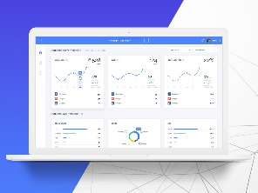





Sales Forecasting – Architecture & Technology Stack
User Interface
Node JS Service
ARIMA Service
History and Forecasting Start Dates
Forecasting Y/N - Flag,
History Data for Prediction,
Forecast data
History and Forecast Data,
Request for
History Data
Fetch the
History Data
Training
Data Set
TCS Internal

Slide 4
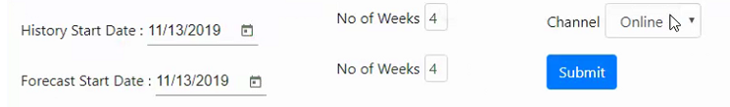
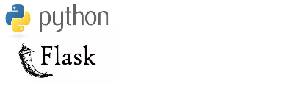
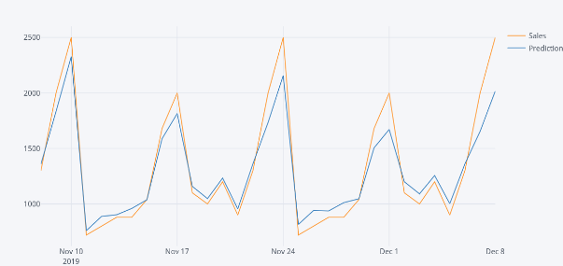
ARIMA Sales Forecasting – Process Flow
In UI , the user requests forecasting by selecting the history dates, the dates which user would like to view and the number of weeks
The channel could be online, instore or phone
By clicking on submit an api call is made by passing this data to the server.
User Interface
Server is core engine between UI and ARIMA service
UI calls Node server API with input data
Connects to mongodb and fetches history data
Based on history data, calls ARIMA service API
Receives forecasting data from ARIMA service
Send back the Forecasting data to UI for user
Server
NodeJS
REST API
Visualize and stationarize the time series
ARIMA Service
Plot ACF charts and find parameters
Forecasting
Build the ARIMA model
REST API
Train and test the model
First order auto regressive model
Make Predictions
TCS Internal

Slide 5


Request – Response Details
User Interface
Node JS Service
MongoDB Service
History Start Date
No. Of weeks
Forecast Start Date
No. Of Weeks
History Start Date
History End Date
Fetch History Data
History Data for the selected period of time
Fetch History Data and Send back to Node Service
ARIMA Service
History Data
Forecast Start Date
Forecast No of Weeks
Product Information
History data in Weeks
Forecasting Data in weeks
Summary Data in months
Run ARIMA with History Data for Forecasting
Receive and format the Forecast data and send
Send Forecasting Data

Slide 6
Assumptions
UI:
Sales Forecasting page is part of an existing application and doesn’t need an Authorization/Login Page to navigate.
History data weeks selection would be minimum of 1 week
Forecast data week selection should be less than or equal to history data weeks
History start date cannot be a future date and Forecast start date cannot be a past date
Node JS:
Forecasting data need not be stored in the database (Mongo DB) and always going to calculate dynamically based on the history data selection
Start Date and No of weeks values for both Historical and Forecasting data will always be received as an input from UI
ARIMA:
Considered one year of Day-wise sales data as history data for two items and three channels
There are no missing values in the Time-Series data, hence data cleaning is not in scope
Current designed model is best-fit for the existing data and has not been tested with outside of the current time-series
History data considered is already stationary in nature and mean, variance and auto-correlation are always constant overtime

Slide 7

DEMO

Slide 8
Thank You
2019
TCS Hackathon
November 17, 2019
TCS Internal

